Slide 1
SHOPIFY SALES ANALYSIS
A Power BI Business Intelligence Project
Prepared by Santanu Pathak
Power BI Desktop | Power Query · Data Modeling · DAX

Slide 2
Agenda
01
Problem Statement
02
Data Preparation & Modeling
Goals, stakeholders & KPIs
Cleaning, star schema & date table
03
Transaction Performance
04
Customer Behaviour
Revenue, orders, AOV & product mix
New vs. returning, RFM segmentation
05
Retention & CLV
06
Insights & Recommendations
Repeat purchase rate, cohorts, lifetime value
Actions for the business
Shopify Sales Analysis · Santanu Pathak
2

Slide 3
Problem Statement
Goal
Build an interactive Power BI dashboard that helps stakeholders understand revenue drivers, customer behaviour, and retention — to guide data-driven decisions.
KPIs Tracked
Total Revenue
Total Orders
Total Customers
Average Order Value (AOV)
Repeat Purchase Rate
Total Tax Collected
Revenue split — New vs. Returning
Customer Lifetime Value (CLV)
Stakeholders
Store owner / founder
Marketing team
Operations & inventory managers
Shopify Sales Analysis · Santanu Pathak
3

Slide 4
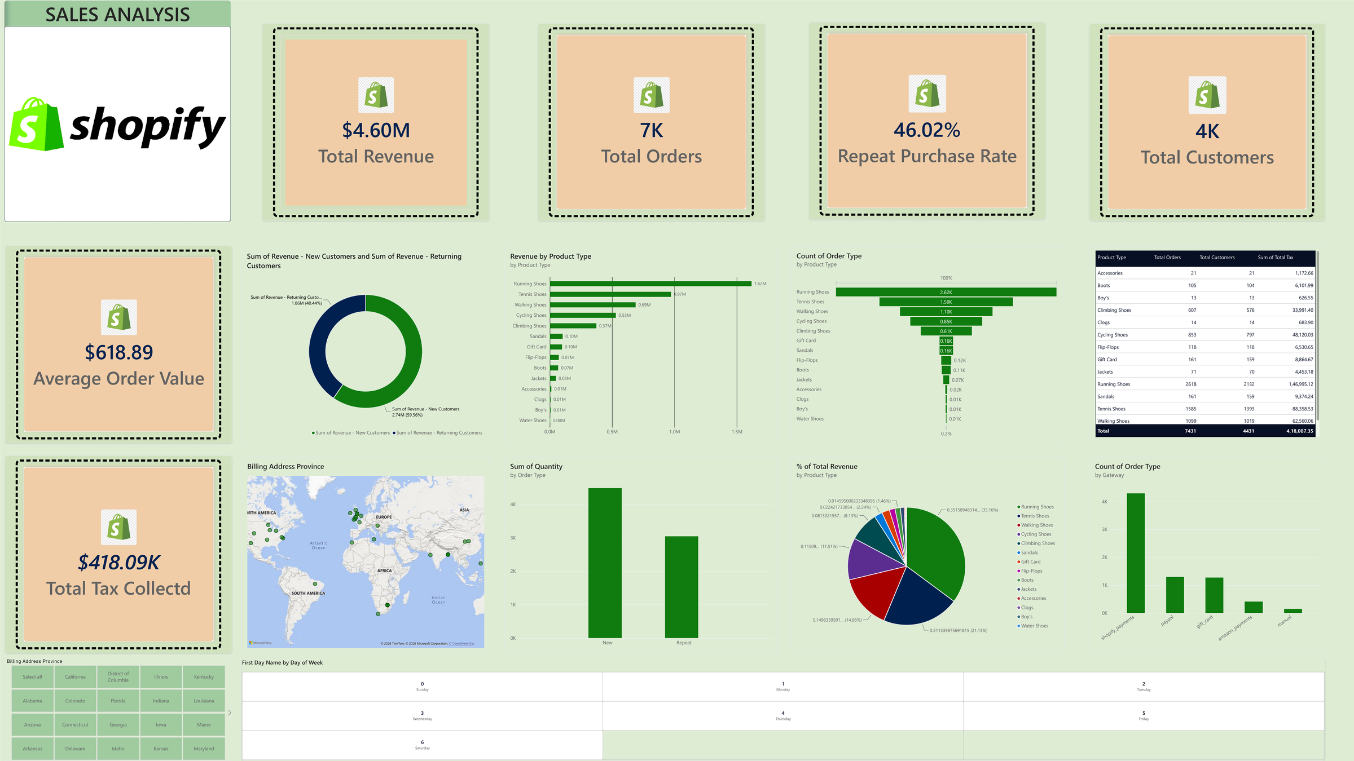
The Dashboard
Interactive Power BI Sales Analysis page
Shopify Sales Analysis · Santanu Pathak
3.5

Slide 5
Headline Performance
Core KPIs from the Sales Analysis dashboard
$4.60M
7,431
4,431
Total Revenue
Total Orders
Total Customers
$618.89
46.02%
$418.09K
Avg. Order Value
Repeat Purchase Rate
Total Tax Collected
Shopify Sales Analysis · Santanu Pathak
4

Slide 6
Revenue by Product Type
Running, Tennis & Walking Shoes drive ~71% of total revenue
71%
of revenue from top 3 categories
<1%
share each from Clogs, Boy's & Water Shoes
Shopify Sales Analysis · Santanu Pathak
5

Slide 7
New vs. Returning Customer Revenue
Returning customers punch above their weight in revenue contribution
$2.74M
New Customer Revenue (59.56%)
$1.86M
Returning Customer Revenue (40.44%)
Insight: a smaller pool of repeat buyers generates a disproportionately large share of revenue — a strong signal to invest in retention.
Shopify Sales Analysis · Santanu Pathak
6

Slide 8
Retention & Customer Lifetime Value
Cohort Analysis
46.02%
Customers are grouped by the month of their first purchase, then tracked month-by-month to see how many return. Retention typically drops sharpest between month 0 and month 1 — the highest-leverage window for re-engagement.
Repeat Purchase Rate
Customer Lifetime Value (Revenue-Based)
Repeat Purchase Rate = DIVIDE(RepeatCustomers, TotalCustomers)
CLV = Average Order Value × Purchase Frequency × Customer Lifespan
Since the dataset has no cost/margin field, CLV is calculated on a revenue basis. The "Champions" RFM segment (frequent, high-spend, recent buyers) shows the highest CLV and should be prioritised for loyalty investment.
Shopify Sales Analysis · Santanu Pathak
7

Slide 9
Customer Segmentation (RFM)
Recency · Frequency · Monetary scoring groups customers into actionable tiers
Champions
Loyal
New / Recent
At Risk
Standard
Recent, frequent, high spend
Frequent & solid spend
First order, recent
Was active, now quiet
Everyone else
Action: reward Champions with loyalty perks; win back At-Risk customers before they churn completely; convert New/Recent buyers into repeat customers within the first 30 days.
Shopify Sales Analysis · Santanu Pathak
8

Slide 10
Key Insights
1
Running, Tennis & Walking Shoes drive ~71% of total revenue — the store's core strength.
2
Returning customers are 40.44% of revenue despite being a smaller share of the customer base.
3
46.02% repeat purchase rate is a healthy baseline, but over half of customers never return.
4
Shopify Payments dominates the payment mix, with PayPal a distant second.
5
Long-tail categories (Water Shoes, Boy's, Clogs) contribute under 1% each — a merchandising review candidate.
Shopify Sales Analysis · Santanu Pathak
9

Slide 11
Business Recommendations
01
02
03
Double down on top categories
Automate a win-back flow
Launch a loyalty tier
Focus marketing & inventory on Running, Tennis & Walking Shoes.
Target first-time buyers within 30 days to lift repeat purchase rate.
Reward the Champions/high-CLV segment to protect their value.
04
05
06
Re-engage At-Risk customers
Review the long-tail catalogue
Optimize checkout
Targeted offers before they churn completely.
Bundle, discount, or phase out Clogs, Boy's & Water Shoes.
Prioritize Shopify Payments & PayPal, the dominant gateways.
Shopify Sales Analysis · Santanu Pathak
10

Slide 12
Thank You
Questions & Discussion
Santanu Pathak
Shopify Sales Analysis — Power BI Project

